Slide 1

Prepared by : Vishal Titre

Slide 2
Table of Contents
1
Version Control System and Understanding Git
2
Git Installation & Configuration
3
Git Command Line operation
4
GitHub Desktop
5
GitHub.com
6
Appendix

Slide 3

Version Control System and Understanding Git
Topics Covered
1 | What is Version Control
2 | Central Version control system (CVCS)
3 | Distributed Version control system (DVCS)
4 | What is GIT
5 | GIT work flow
6 | How Git stores Data into Database

Slide 4
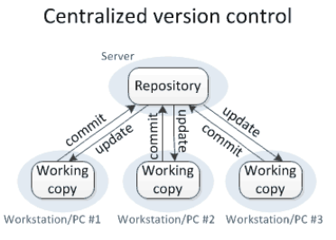
What is Version Control
Version control is a system that records changes so that you can recall specific versions later.
Version control enables multiple people to simultaneously work on a single project. Each person edits his or her own copy of the files and chooses when to share those changes with the rest of the team. Thus, temporary or partial edits by one person do not interfere with another person's work.
Version control software keeps track of every modification to the code in a special kind of database. If a mistake is made, developers can turn back and compare earlier versions of the code to help fix the mistake while minimizing disruption to all team members.
Version control integrates work done simultaneously by different team members. In most cases, edits to different files or even the same file can be combined without losing any work. In rare cases, when two people make conflicting edits to the same line of a file, then the version control system requests human assistance in deciding what to do.
Version Control software allows you to revert files back to a previous state, revert the entire project back to a previous state, compare changes over time, see who last modified something that might be causing a problem, who introduced an issue and when, and more.
Centralized Version Control System Vs Distributed Version control system
Centralized Version Control System:
All the versioned files are stored at centralized server. Users perform check-in and check-out of code from central place.
This system give clear views to developers on what others are doing on the code .
It is easy to admin and control .
If the main server goes down the developers can’t save versioned changes (single point of failure).
If the hard disk of the central database becomes corrupted the entire history could be lost.
In centralized version control, each user gets his or her own working copy, but there is just one central repository. As soon as you commit, it is possible for your co-workers to update and to see your changes. For others to see your changes, 2 things must happen:
You commit
They update

Slide 5
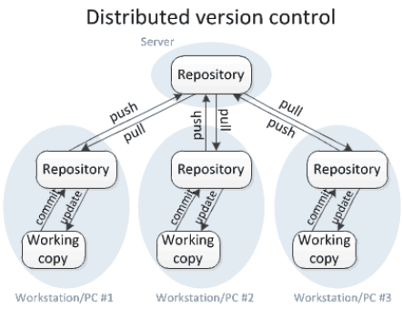
Distributed Version control system:
Distributed Version Control Systems (DVCSs) don’t rely on a central server.
In DVCS Instead of a working copy, each developer gets their own local repository, complete with a full history of commits.
If the sever goes down, then the repository from any client can be copied back to the server to restore it.
Every checkout is a full backup of the Server repository.
Require network connection only to publish (Push) your changes and take the latest changes (Pull).
Performing actions other than pushing and pulling changesets is extremely fast because the tool only needs to access the hard drive, not a remote server.
You can commit changes, create branches, view logs, and perform other operations when you are offline.
Performing actions other than pushing and pulling changesets is extremely fast because the tool only needs to access the hard drive, not a remote server.
In distributed version control, each user gets his or her own repository and working copy. After you commit, others have no access to your changes until you push your changes to the central repository. When you update, you do not get others' changes unless you have first pulled those changes into your repository. For others to see your changes, 4 things must happen:
You add
You commit
You push
They pull
They update
In DVCS commit and update commands only move changes between the working copy and the local repository, without affecting any other repository. By contrast, the push and pull commands move changes between the local repository and the central repository, without affecting your working copy.

Slide 6
What is Git ?
Git is an open-source version control system that was started by Linus Trovalds – the same person who created Linux.
Git is a mature, actively maintained open source project originally developed in 2005 by Linus Torvalds.
Git is an example of a DVCS (Distributed Version Control System). Rather than have only one single place for the full version history, in Git, every developer's working copy of the code is also a repository that can contain the full history of all changes.
In addition to being distributed, Git has been designed with performance, security and flexibility in mind.
Git uses a common cryptographic hash function called secure hash function (SHA1) to store the data in to Git Database.
Having a full local history makes Git fast, you don’t need a network connection to create commits, inspect previous versions of a file, or perform diffs between commits.
Git use blob, tree, commit and tag objects to store the details of data.
Default Git configuration file location is .git/config.
Advantages of Git:
Free and open source : You can use Git to manage propriety projects without paying a single penny. As it is an open source, you can download its source code and also perform changes according to your requirements.
Fast and small : The core part of Git is written in C, which avoids runtime overheads associated with other high-level languages. Though Git mirrors entire repository, the size of the data on the client side is small. This illustrates the efficiency of Git at compressing and storing data on the client side.
Implicit backup : Data present on any client side mirrors the repository, hence it can be used in the event of a crash or disk corruption.
Security : Git uses a common cryptographic hash function called secure hash function (SHA1), to name and identify objects within its database. it is impossible to change file, date, and commit message and any other data from the Git database without knowing Git.
No need of powerful hardware: In GIT, developers don’t interact with the server unless they need to push or pull changes. All the heavy lifting happens on the client side, so the server hardware can be very simple indeed.
Easier branching : management with Git is very simple. It takes only a few seconds to create, delete, and merge branches.

Slide 7
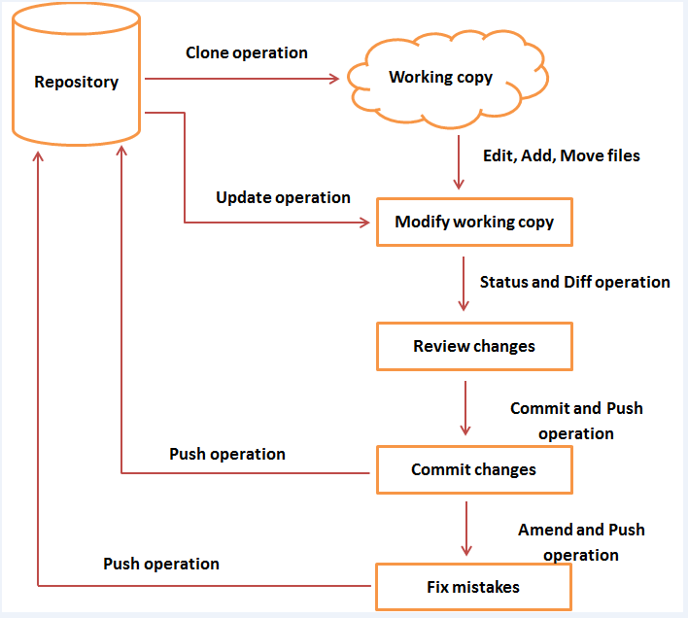
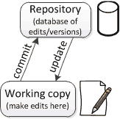
Git Workflow
General workflow of Git is as follows:
You clone the Git repository as a working copy.
You modify the working copy by adding/editing files.
If necessary, you also update the working copy by taking other developer's changes.
You review the changes before commit.
You commit changes. If everything is fine, then you push the changes to the repository.
After committing, if you realize something is wrong, then you correct the last commit and push the changes to the repository.
Git Repository is a database of all the historical versions (snapshots) of your project. It is possible for the repository to contain edits that have not yet been applied to your working copy. You can update your working copy to incorporate any new edits or versions that have been added to the repository since the last time you updated.
working copy is your personal copy of all the files in the project. You make arbitrary edits to this copy, without affecting your teammates. When you are happy with your edits, you commit your changes to a repository

Slide 8
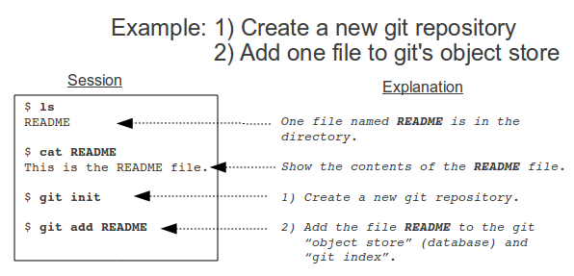
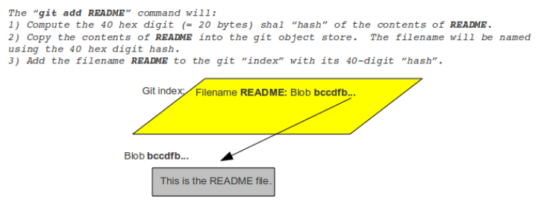
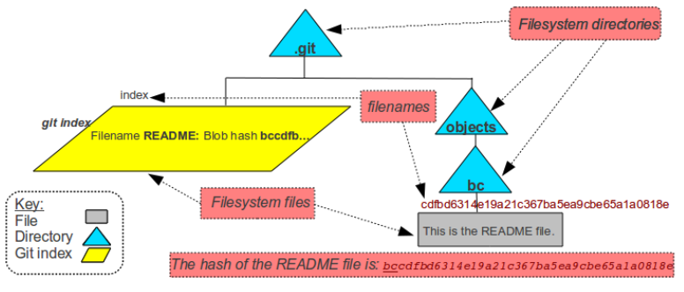
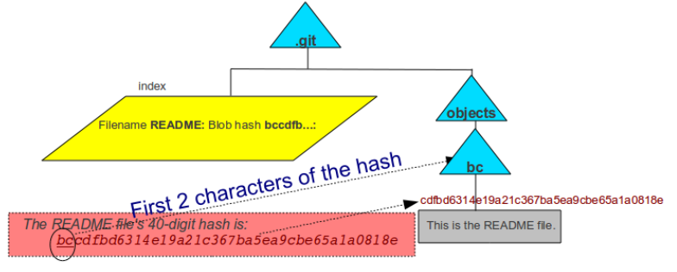
How Git Store Data into Database (git add operation)
Below are the action performed in background when you execute git add README command :
Compute the 40 digit hex code of the content of README
Copy the contents of README into the git database.
The filename will be named using the 40 hex digit hash
Add the filename README to the git "index" with tits 40-digit hash.
Git stores the contents of user files in .git/objects.
The first two digits of the hash of the README file is XX so a directory was created by the name XX. The rest of the hash is used as the filename in the XX directory.
Two files with identical contents will have the same hash value. Two files with different contents will have different hash values.
Git stores compressed versions of files and can also “pack” files to save disk space.
For referring to particular file no need to type complete 40- character has value , we can use first 6 digit of the hash value.
Index is the staging area where files are added (e.g. “git add”) and removed (e.g. “git rm”) before they are committed to a repository. Files start in the user’s working directory before moving to the index.

Slide 9
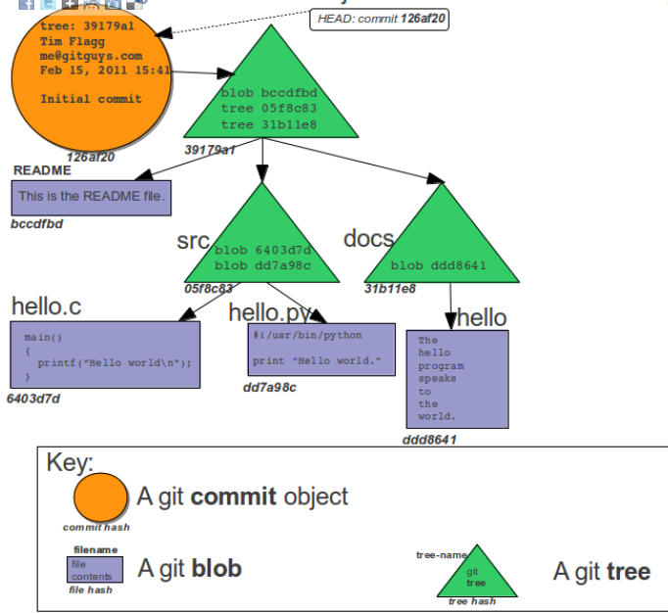
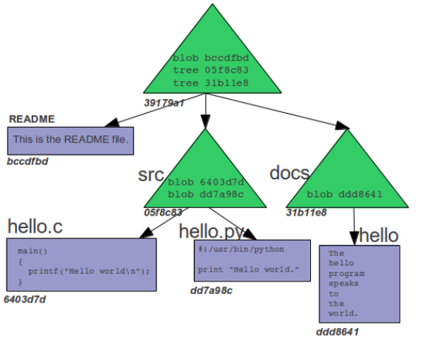
How Git Store Data into Database (git commit operation)
Once you create new file or done with editing the existing file in working copy you need to coming or check-in the code to update the repository .
When you use git commit to update the repository, git creates a new commit object, which is also saved to the git repository.
Commit object includes:
The hash of the Git tree that represents the state of the index at the time of the commit.
Commiter: The name and email address of who did the git commit, along with a date/time.
Comment: A text comment that summarizes the reason for the commit.
Since commit objects are part of the object database, they not only have a hash value, but are referred to by their hash.
After every git commit, git has a complete record of the contents of every file and directory that was in the index to be committed at the time of the commit.
The HEAD pointer, points to the most recent commit on the current branch.

Slide 10
Git Installation & Configuration
Topics Covered
1 | Installation of GIT on Ubuntu Server
2 | Installation of GIT on Windows Server
3 | Git tools

Slide 11
Git Installation and Configuration on Ubuntu Linux
Add new user into server to admin git environment.
As Root user create new folder (Git home directory) under git admin user home directory . Change the ownership of that folder to git admin User .
Provide sudo permission to newly added git admin user.
To Install Git Version Control System on Ubuntu Server Run below command with Sudo Permission. $ Sudo apt-get install git
Generate the Public /Private key pairs using ssh-keygen command for user authentication
Once Git installation is complete execute below command to configure the Git Environment . Git use these details to embeds into each commit we do.
$ git config --global user.name "Your Name" # Configure you name to embed into each commit we do.
$ git config --global user.email "youremail@domain.com" # Configure you email ID to embed into each commit we do.
$ git config --global core.editor vim # Set default editor
$ git config –list # to see all the configuration details.
Git Installation and Configuration on Windows Machine
Refer Below links for step by step instruction with screenshots to install Git on Windows Machine and Generating SSH Keys:
Instruction URL : https://blog.assembla.com/AssemblaBlog/tabid/12618/bid/77264/Setting-Up-Git-on-Windows-in-Four-Easy-Steps.aspx

Slide 12


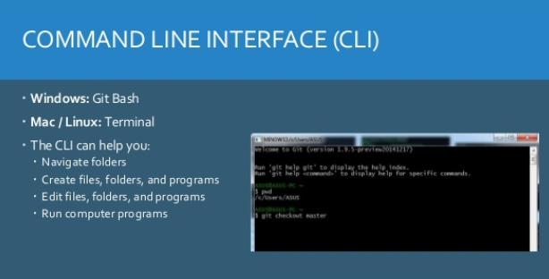
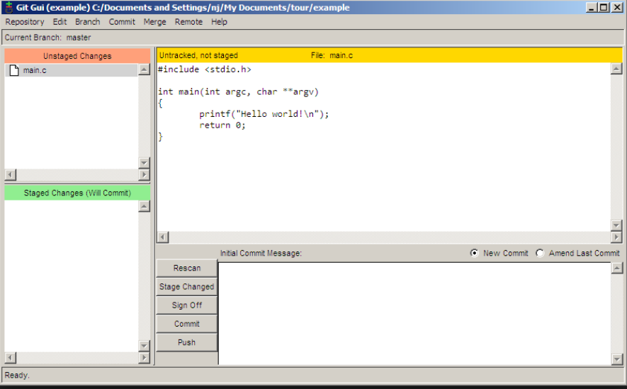
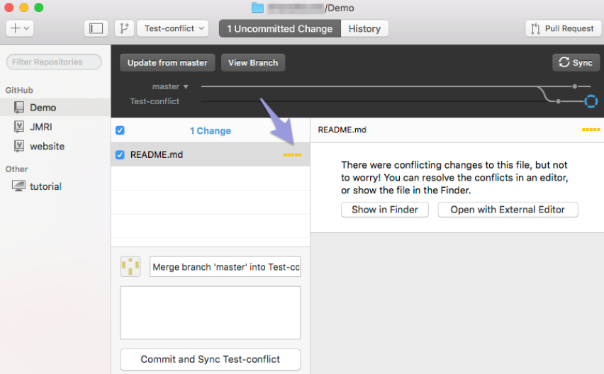
Git Tools
Remote Repository Container
End User Applications for accessing Git

Slide 13
Git Command line Operations
Topics Covered
1 | GIT Shared Remote Repository
2 | GIT local Repository
3 | Creating , Indexing and Committing file
4 | Pushing files to Remote Repository
5 | Cloning Remote Repository to Local working directory
6 | Reviewing the changes
7 | GIT Branching & Stashing
8 | GIT Merging

Slide 14
Git Repository
Shared Remote Repository Vs Local Repository
Shared Remote Repository:
When creating a central repository that will be shared by other users, the bare repositories should be created with the –bare option
When you create a git repository with the –bare option:
There is no working directory created.
There is no .git directory created and contents of .git directory are present directly inside it.
bare git repositories should end in .git. The .git ending of a directory signals to others that the git repository is bare.
Syntax : git init -- bare <Repository name>.git
Local Repository :
When you create the local repository for your own use which you don’t want to share with other in the team, you can create non-bare directory.
Normal non bare repository basically made up of 2 components :
Working directory : In simple terms it is the place where all checked out files reside and file available in this location can be added to git repository by “ git add FILE_NAME” command.
.git Directory : In simple terms this directory contains all the administrative related files and data that are required by GIT to support all the commands like git commit, git status , git pull, git push. This directory is always present in the root of your project directory.
Syntax : git init <Repository name>
Local Repository
Remote Repository
Git clone
Copies the whole remote repository to local repository.
Git Pull
Retrieve any updates from the remote repository that aren’t yet in the local repository and merges them into the local repository
Git push
Publish updates from local repository to the remote repository
Branch : master
Branch : master

Slide 15
Git command line operations
If you want to participate in a project using git, you can follow this standard workflow:
git clone URL: After you have done a git clone, you have a copy of the complete repository.
Make some changes to the local version of the repository, then git add and git commit the changes to the local repository.
git push to publish the changes (“commits”) to the remote repository
Periodically git pull to retrieve any new updates from the remote repository.
For better understanding of git commands we will use below setup:
Remote server 192.168.0.1 and created new admin user “gitadmin”
Remote Repository directory name “repo.git”
Remote Repository URL: gitadmin@192.168.0.1:repo.git
It is assumed that git client is installed on all workstations.
It is assumed that ssh authentication is already setup for passwordless transaction between Remote repository server and workstations.
Create local repository onto workstation and add file into it:
$ mkdir /home/user1/gitrepo
$ cd /home/user1/gitrepo
$ git init # it will initialized the empty git Repository in /home/user1/gitrepo/.git
$ echo “Hi All, Welcome to fist steps towards learning the Git operations” > README # Add the README file with some contents
Add newly created file into Index (Staging area): $ cd /home/user1/gitrepo $ git add REAMDE # Added README file into Index (staging area) and are ready to perform the commit into local repository.
Git Operation

Slide 16
Git command line operations Continued ….
View the status of your files in the working directory and staging area :
$ git status -s # give status of your staging area compared to the code in your working directory # -s option will give you short output. # A : file is newly added , AM : file is modified on disk since we last added it, # D : files that were deleted since your last commit, M : files that were modified or staged since your last commit.
After indexing the changes , Record/Update the changes into local repository using “git commit” command: $ git commit –m ‘This is my initial commit’ # This will update the changes into local master repository
# Post this commit now you can push data to Remote Repository. # If you leave off the -m option, Git will open a text editor to write commit message.
Copy the Git Remote repository from Remote Server to Workstation into local repository:
$ cd /home/user1/gitrepo # Change current working directory to Local Repository directory.
$ git clone gitadmin@192.168.0.1:repo.git # Copy complete Repository from remote server to local Repository.
Working with Remotes:
$ git remote –v # Shows the remote servers you have configured
# -v option show the URL that git has stored for shortname to be used when reading and writing to that remote.
$ git remote add <shortname> <url> # To add shortname to new Remote Git Repository for easily reference
Example : $ Git remote add gitadmin gitadmin@192.168.0.1:repo.git # Added shortname “gitadmin” for Remote Git Repository gitadmin@192.168.0.1:repo.git
$ git remote show <remote-name> # It will show more information about particular remote.
$ git remote rm <Remote Shortname> # It will remove the Remote details
$ git remote set-url <shortname> <new URL> # It will use to update the remote location for particular Shortname

Slide 17
Git command line operations Continued ….
To update a remote repository with the changes you've made locally use “git push” command:
$ git push <shortname> <branch>
Note :You can push any branch to any remote repository that you have write access to in this way. If your branch is already on the server, it will try to update it, if it is not, Git will add it. Git push command will take what your [branch] looks like and push it to be [branch] on the remote, if possible. If someone else has pushed since you last fetched and merged, the Git server will deny your push until you are up to date.
To see the log details using “git log” command:
$ git log
To Pull the data from Remote repository that you don’t have yet on Local Repository use “git fetch ” and “git merge” command: $ git fetch <remote repository short name> # Pull all data from Remote repository that you don’t have in local repository. $ git merge <remote repository short name> / <branch> # To merge into your current branch anything new you see on the server.
To see the changes between any two commit use “git diff” command . Note : This is largely used in two main situations - seeing how two branches differ from one another and seeing what has changed since a release or some other older point in history. Let's look at both of these situations.
$ git diff <branch A > < branch B> # To inspect branch B relative to branch A.
$ git diff <version> # To see what has changed since the last release.

Slide 18
Git Branching & Stashing
When you first create a git repository (with a command such as git init), one branch is created. It’s your main (and only) branch. The branch, by default, is named master.
When you make that first addition to the repository, the first addition is usually made to that one branch, The master branch.
Using Git branch command list all the branches in the repository . The asterisk that is placed to the left of branch name is git branch command output indicates the current branch in the repository. $ git branch.
HEAD is used by git to refer to the current commit you are working on. HEAD config file (.git/HEAD).
$ git branch <new branch name> # Use below command to create new Branch.
$ git branch # List all branches in the repository, current branch is indicated by *
$ git checkout <branch name> # Switch to new branch.
$ git ls-files # Display all files on current branch.
$ git branch –d <branch name> # Delete the branch.
$ git checkout –m <branch name> # Tells git to merge in any conflicts, before switching branches.
$ git show-branch # Shows the branches and the commit history.
$ git merge <branch name> # to merge the branch to into current branch
Stashing your work:
If you are in situation that you modifying files in the working directory and/or index and you find out you need to fix a bug on a different branch. You can’t just switch to a different branch and lose all your work. In such situation you can use “git stash” command.
Git stash command perform below action:
Saves your working directory and index to a safe place.
Restores your working directory and index to the most recent commit.
Once you are done with the work on other branches, make commits, etc. and when you’re ready to get back to where you were, you type “git stash pop” and you’re back.
Note : “git stash” will not stash (save) files in the working directory unless the files are being tracked (some version of the file has been added to the index).
Syntax : $ git stash # Saved the uncommitted but indexed files details into safe area.
$ git stash pop # To retrieve the saved files details into working directory.

Slide 19
GitHub Desktop
Topics Covered
1 | Installing of GitHub Desktop
2 | Authenticating to GitHub
3 | Configuring GitHub Desktop
4 | GitHub Desktop basic setting

Slide 20
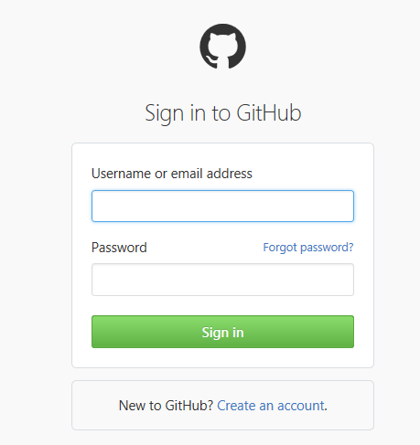
GitHub Desktop
Login to Github.com website and create the account.
Installation of GitHub Desktop on Microsoft windows 7 or later | Visit the GitHub Desktop download page. Choose Download for Windows. In your computer's Downloads folder, double-click GitHub Desktop. In the pop-up window, click Install. After the program has been installed, click Run.
Configuring Git for GitHub Desktop | Sign in to GitHub or GitHub Enterprise. For GitHub.com or GitHub Enterprise 2.3 or higher, in the top right corner of any page, click your profile photo, then click Settings. In the left sidebar, click Emails. Copy the email address you'd like to use in your local Git configuration. Return to GitHub Desktop. Choose Options. Under Configure Git, in the Full name field, type the name you'd like to use for your Git configuration. In the Email field, paste the email address you copied from your GitHub or GitHub Enterprise account settings.
Authenticating to GitHub Desktop 2FA Via SMS, 2FA Via TOTP, CAS, WEB FLOW | In the upper-right corner of the app, click. Choose Options. Under Accounts, click Add account. Under Log in, choose GitHub or GitHub Enterprise, depending on which product you're using. Type your credentials, then click Log in.

Slide 21
GitHub Desktop Continued…
GItHub Desktop Basic settings | On Github Desktop In the upper-right corner of the app, click. Choose Options. View and make changes to your settings: Under Accounts, click Add account to add or remove a GitHub or GitHub Enterprise account. Under Git config, type new information to edit your Git configuration. Under Clone path, specify a default directory for new repositories. Under Default shell, choose the Git shell you'd like to use with GitHub Desktop. Under Privacy, opt in or out of sending anonymous usage data to GitHub.
Cloning a repository from GitHub Desktop | In the top left corner of the app, click At the top of the menu, click Clone. In the left sidebar, do one of the following: To work with a personal repository, select your username. To work with a repository that belongs to an organization you're a member of, select the name of the organization. In the list of repositories for the selected account, click the repository you'd like to clone At the bottom of the menu, click Clone REPOSITORY.

Slide 22
GitHub.com
Topics Covered
1 | What is GitHub ?

Slide 23
What is GitHub ?
GitHub is a web-based Git repository hosting service. It offers all of the distributed revision control and source code management (SCM) functionality of Git as well as adding its own features.
GitHub Repository: A repository is a location where all the files for a particular project are stored, usually abbreviated to “repo.” Each project will have its own repo, and can be accessed by a unique URL.
Forking a repo: “Forking” is when you create a new project based off of another project that already exists. If you find a project on GitHub that you’d like to contribute to, you can fork the repo, make the changes you’d like, and release the revised project as a new repo. If the original repository that you forked to create your new project gets updated, you can easily add those updates to your current fork.
Pull request : You fork a repository, make a great revision to the project, and want it to be recognized by the original developers, maybe even included in the official project/repository. You can do so by creating a pull request, so the authors of the original repository can see your work, and then choose whether or not to accept it into the official project. Whenever you issue a pull request, GitHub provides a perfect medium for you and the project’s maintainer to communicate.
Social networking: The social networking aspect of GitHub is probably its most powerful feature, and is what allows projects to grow more than anything else. Each user on GitHub has their own profile, which can act like a resume of sorts, showing your past work and contributions to other projects via pull requests. Project revisions are able to be discussed publicly, so a mass of experts can contribute knowledge and collaborate to advance a project forward.
Changelogs : When multiple people are collaborating on a project, it’s really hard to keep track of who changed what, and to keep track of the revisions that took place. GitHub takes care of this problem by keeping track of all the changes that have been pushed to the repository.
Reference Url: https://guides.github.com/activities/hello-world/

Slide 24
Appendix
Topics Covered
1 | Reference links
2 | GitHub Desktop Authentication
3

Slide 25
Back
GitHub Desktop Authentication
You can use two-factor authentication, a central authentication service, or the web authentication flow to sign in to GitHub Desktop.
About 2FA Two-Factor Authentication:
Two-factor authentication, or 2FA, is a way of logging into websites that requires more than just a password. Using a password to log into a website is susceptible to security threats, because it represents a single piece of information a malicious person needs to acquire. The added security that 2FA provides is requiring additional information to sign in.
In GitHub's case, this additional information is an authentication code that's generated by an application on your smartphone or sent as a text message (SMS). After 2FA is enabled, GitHub generates an authentication code any time someone attempts to sign into your GitHub account. The only way someone can sign into your account is if they know both your password and have access to the authentication code on your phone.
2FA Via SMS :
If you set up two-factor authentication via text messages, GitHub will send you a text message with your authentication code. After entering your username and password, you'll be asked for your "Two-factor authentication code." This will automatically be delivered to your phone via text message. You can then enter this code to gain access to your account.
Note : GitHub Doesn't support sending SMS message to India
Steps to Configure 2FA via SMS:
In the top right corner of any page, click your profile photo, then click Settings. .
In the user settings sidebar, click Security.
Under Two-Factor Authentication, click Set up two-factor authentication.
On the Two-Factor Authentication page, click Set up using SMS..
Select your country code and type your mobile phone number, including area code. When your information is correct, click Send code. .
You'll receive a text message with a security code. Type the code on the 2FA page, and click Enable. .
Download your recovery codes and save them in a safe place, such as a password manager. Your recovery codes are to be used in the event you lose access to your account.

Slide 26
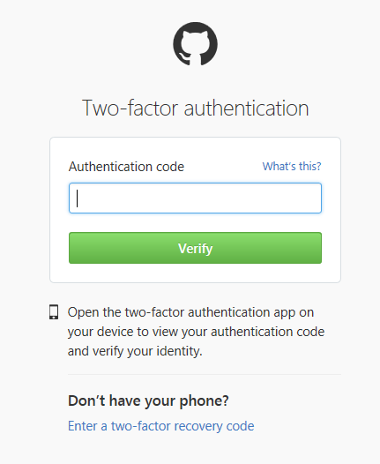
Back
GitHub Desktop Authentication Continues…
2FA Via TOTP :
If you chose to set up two-factor authentication using a TOTP application on your smartphone, you can generate an authentication code for GitHub at any
time. After entering your username and password, you'll be asked for your "Two-factor authentication code".
Time-based One-Time Password (TOTP) application automatically generates an authentication code that changes after a certain period of time.
Steps to Configure 2FA via TOTP:
Download one of these apps:
For Android, iOS, and Blackberry: Google Authenticator
For Android and iOS: Duo Mobile
For Windows Phone: Authenticator
In the top right corner of Github.com webpage, click your profile photo, then click Settings. .
In the user settings sidebar, click Security.
Under Two-Factor Authentication, click Set up two-factor authentication.
On the Two-Factor Authentication page, click Set up using an app..
On the "Add GitHub to your two-factor authentication app" page, do one of the following:
Scan the QR code
Manually type the security code into your TOTP application. If you're using Microsoft Authenticator, you'll need to use this method.
The TOTP mobile application will save your GitHub account and generate a new authentication code every few seconds. In GitHub, on the 2FA page, type the code and click Enable. .
Download your recovery codes and save them in a safe place, such as a password manager. Your recovery codes are to be used in the event you lose access to your account.

Slide 27
Back
GitHub Desktop Authentication Continues…
Authenticating to GitHub Enterprise with CAS:
Sign in to your GitHub Enterprise instance.
Depending on which version of GitHub Enterprise you're using, do one of the following:
For GitHub Enterprise 2.0, 2.1, or 2.2, in the top right corner of any page, click
For GitHub Enterprise 2.3 or higher, in the top right corner of any page, click your profile photo, then click Settings.
Depending on which version of GitHub Enterprise you're using, do one of the following:
For GitHub Enterprise 2.0, 2.1, or 2.2, in the user settings sidebar, click Personal access tokens.
For GitHub Enterprise 2.3 or higher, in the user settings sidebar, click Applications.
Click Generate new token. .
Copy the token to your clipboard. For security reasons, after you navigate away from this page, you will not be able to see the token again. .
Launch GitHub Desktop.
In the upper-right corner of the app, click
Choose Options.
Under Accounts, click Add account.
Under Log in, choose GitHub Enterprise.
Type your username and GitHub Enterprise URL. In the password field, paste the OAuth token you copied earlier. .
Click Log in.
Authenticating to GitHub Enterprise with web flow:
Note : Authenticating with web flow is only supported using the Safari web browser.
Sign in to your GitHub Enterprise instance.
Launch GitHub Desktop.
In the upper-left corner of your screen, select the GitHub Desktop menu.
Choose Preferences.
In the Preferences window, select Accounts.
Click Add an Enterprise Account.
In the URL field, enter the URL for your GitHub Enterprise installation. .
Leaving the other fields blank, click Sign In. .
After GitHub Desktop authenticates your account in Safari, return to GitHub Desktop..

Slide 28
GitHub Desktop Security Continues…

Slide 30
Reference Site
https://www.atlassian.com/git/tutorials/why-git
http://www.tutorialspoint.com/git/git_life_cycle.htm
http://maxivak.com/setting-up-and-using-git-on-windows-and-ubuntu/
https://git-scm.com/book/en/v2/Getting-Started-About-Version-Control
https://www.appfusions.com/display/StashSCMImporter/CVCS+vs.+DVCS+In+a+Nutshell
https://betterexplained.com/articles/a-visual-guide-to-version-control/
https://homes.cs.washington.edu/~mernst/advice/version-control.html
https://www.appfusions.com/display/StashSCMImporter/Why+DVCS+and+git
http://matthew-brett.github.io/pydagogue/git_gui_windows.html
https://nathanj.github.io/gitguide/tour.html
http://www.gitguys.com/topics/the-git-object-model-starting-with-the-blob/ --------- ******
http://techidiocy.com/bare-and-non-bare-repositories-git-directory-and-working-tree/
http://www.vogella.com/tutorials/Git/article.html#workingtree
http://gitref.org/basic/
https://help.github.com/desktop/guides/contributing/committing-and-reviewing-changes-to-your-project/

